Slide 1
CODE Framework
Thom Chichester
tchichester@eps-software.com
Notes:
Content starts on slide 6

Slide 2









About the Presenter
Thom Chichester
Senior developer & Project Manager EPS Software Corp.
Author and Speaker
President of Houston Designers & Developers
Special Interest Group (D2SIG)

Slide 3

About CODE & EPS Software Corp.
Custom Software, Training, and Consulting
.NET, SQL Server, SharePoint,…
Specialists in converting to .NET
Object and Service Oriented Development
Database Development
User Interface/ Web
ASP.NET, WinForms, WPF, Silverlight, iPhone

Slide 4

Tower 48 Software Escrow
Tower 48 is a Digital Software Escrow company owned by CODE/EPS
What is software escrow?
“What if you get run over by a truck?” – escrow fixes this problem
Why Tower 48?
Because it is inexpensive, high-tech, and you can actually make money with it!
www.Tower48.com

Slide 5
EPS is Hiring!
We are currently hiring all positions!
Project Management, Developers, Designers
Employees and Contractors
CODE Network
Send us an email if you are interested or know someone!
jobs@eps-software.com

Slide 6
Elevator Speech
CODE Framework – What is it?
A .NET application development framework/utility library
N-Tier & SOA Architecture
Not-quite RAD
How to get it?
Point of Entry: www.codemag.com/framework/GetStarted
Maintenance: Visual Studio Gallery
How much is it?
FREE
Open Source: http://codeframework.codeplex.com

Slide 7
Agenda
Brief history of N-Tier architecture
Describe MVVM & MVC patterns
Describe CODE Framework’s MVC implementation

Slide 8

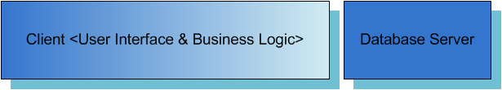
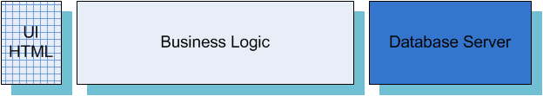
Monolithic to Three Tier
Monolithic
Client Server
Three Tier

Slide 9
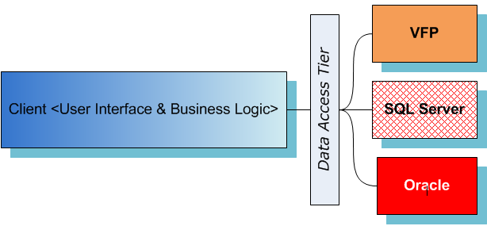
Data Access Tier

Slide 10
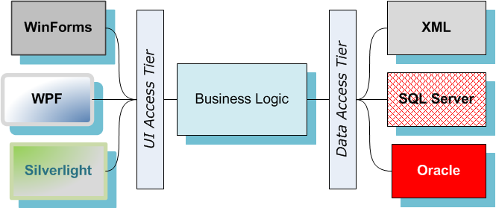
N-Tier: User Interface Tier

Slide 11
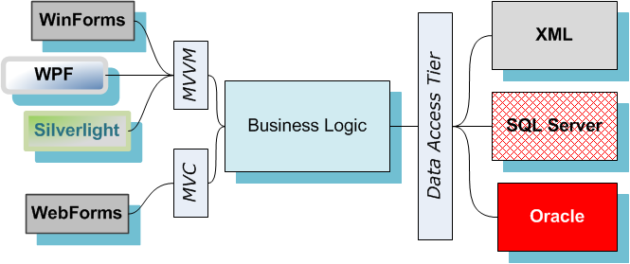
UI Tier Design Patterns

Slide 12
Model View ViewModel

Slide 13
Model View Controller

Slide 14
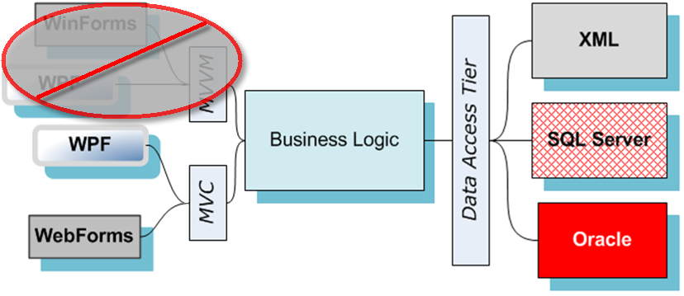
CODE Framework’s UI Tier

Slide 15
CODE Framework UI Architecture

Slide 16
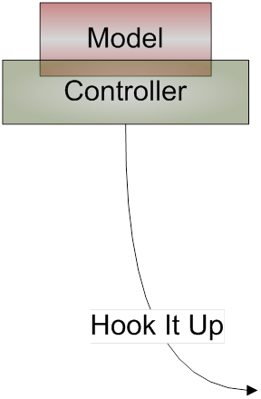
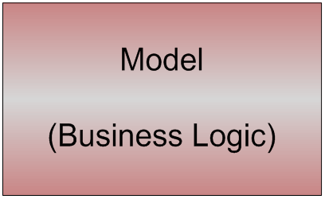

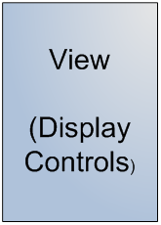
CODE Framework – 4 Step Process
Model
View
Controller
Hook It Up

Slide 17

Q&A Contact us with questions!
CODE/EPS Contact:
www.codemag.com
info@codemag.com
facebook.com/codemag
twitter.com/codemagazine
Presenter Contact:
tchichester@eps-software.com

Slide 18
CODE Training
CODE Magazine is now offering training classes!
On-site and remotely
Various Topics Announced!
WPF & Silverlight
WCF
ASP.NET Ajax, MVC, jQuery,…
Azure
iPhone for .NET Developers
…
Custom training and mentoring also available

Slide 19

CODE Training Coupon
Get a discount of CODE Training classes
See the schedule at www.codemag.com/training
To get the discount, email Patrick at plashford@eps-software.com

Slide 20

Free CODE Consulting
You are also entitled to a free 1-hour consultancy if you need a recommendation as to what technologies to use in your project(s)
Also contact Patrick plashford@eps-software.com

Slide 21

Check out our Podcast!
CodeCast
The Late Night Show for .NET Developers
Companion Podcast to CODE Magazine
codemag.com/codecast

Slide 22

CODE Magazine Offer
As an attendee to this event, you are entitled to a free subscription! ☺
Use this special signup URL: codemag.com/subscribe/Markus

